Slide 1
SOHO-29, 22 years… !!!
GOLF status and long time-series
Patrick Boumier, Thierry Appourchaux

Slide 2
Plan
Instrument status / operations
Reduction of data:
- time stamp
- concatenated series
Present and future

Slide 3
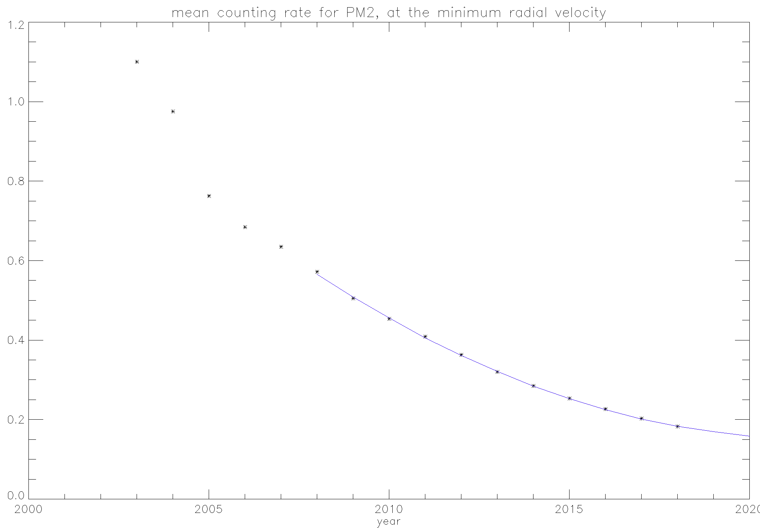
Instrument status – counting rates
10⁶ c/s
still largely sufficient to measure p modes with a high signal-to-noise ratio

Slide 4
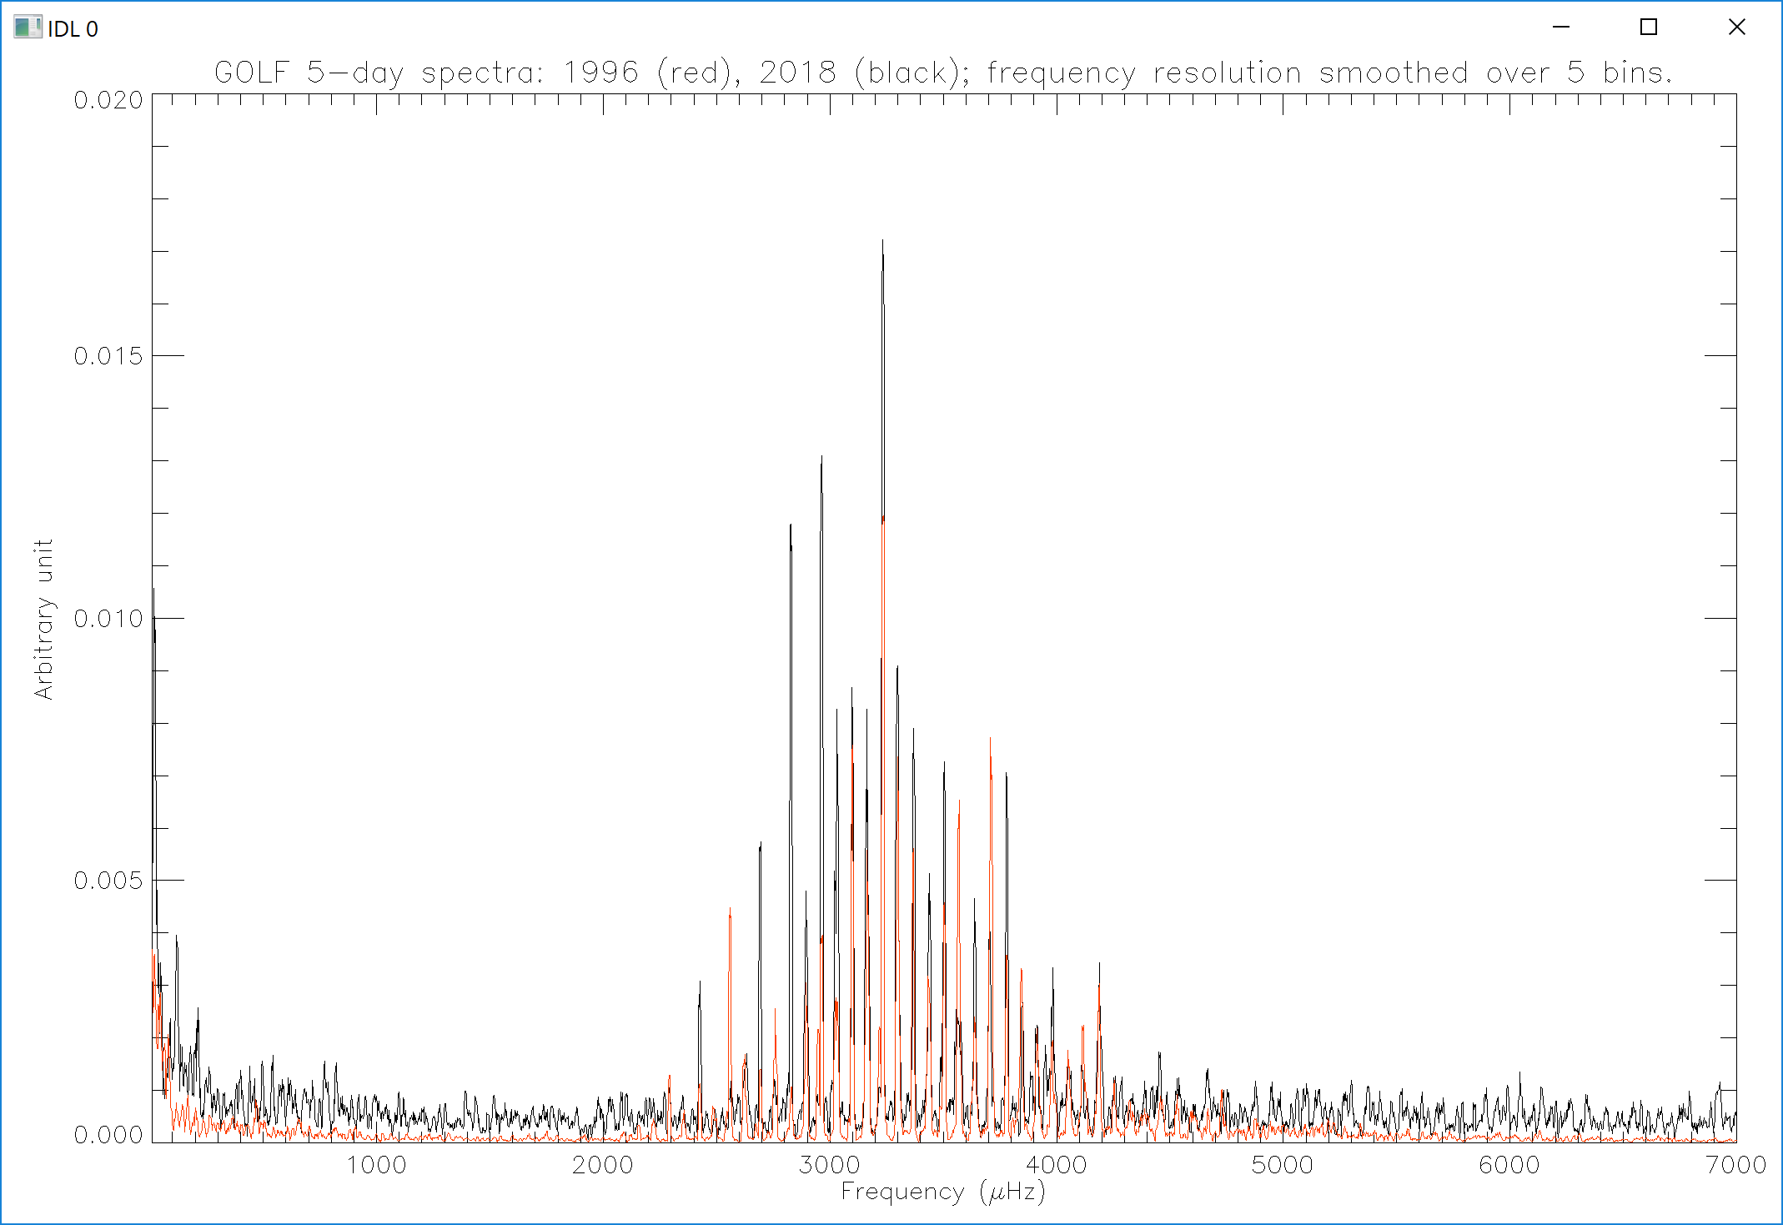
Instrument status – p-modes SNR

Slide 5
Instrument status – operations
Anomalies
  - November 2014 23rd: magnetic modulation went OFF. Several % decrease of the counting rates & temperature decrease of 2 to 4 degrees. The log book displays wrong status of parameters (heating, high voltage…). “Switch ON the Magnetic modulation TC” sent to GOLF: back to nominal but the log book. Quick look plots and tables are OK; check in the L1 daily fits file that scientific and housekeeping data are OK. 5 days with non nominal counting rates
  - September 2015 1st: DPU routine crash. OFF&ON procedures: back to nominal; 3 or 4 days lost. Note that the log book went back to nominal.
  - February 2016: SOHO warm startup. A new OBT was automatically transmitted to GOLF. 30-second gap in the time series.
Functionning
- March 2014: change of PM high voltages (26 V & 42 V for PM1 & 2) : gain 1% of photons.
- Septembre 2015: update of g_fl_halon_m starting procedure.

Slide 6
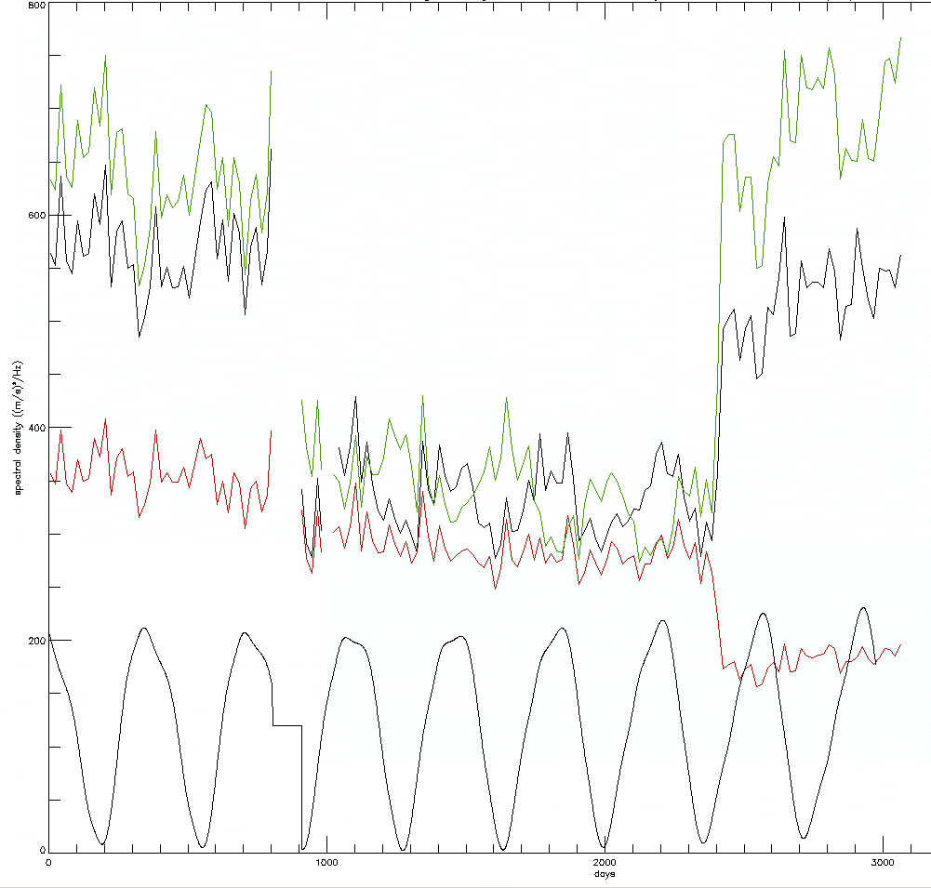
Reduction, corrections and calibration
Why a new velocity calibration ?
3 calibrations tried in the past
⇓
3 different results for the global energy of the 5-mn oscillations [2.5; 4.5] mHz
Behavior in opposite way versus
the orbital velocity, ie versus the
altitude in the solar photosphere

Slide 7
GOLF Housekeeping : Daily Pulse ; TAI
GOLF Local On Board Time (LOBT) : driven by the SOHO OBT (On Board Time). This OBT is specified to always be within 20 ms of TAI (Temps Atomique International).
DP: daily pulse sent at TAI = midnight + 30 sec.
However, the GOLF temporal sampling suﬀered some delays during its lifetime, either due to SOHO reconfigurations, or to operational events.
Ground segment (daily FITS files): TAI value of the first block given for every day (start of the observation).

Slide 8
What to do ?
Daily files: check the datation (with an independent input).
Long time series: choose a datation philosophy; either regular sampling or keep the operational one.
Till now, everybody used regular samplings without interpolation.
Special care due to the « one-wing only mode of operation », which has changed twice.

Slide 9
BW / RW : Pallé et al, Renaud et al (1999)
100
GOLF
80
GOLF vs Mark-I
60
(o)
40
MKI
20
^{b} − Φ
0
−20
−40
<∆Φ> = −9.º1 ± 2.º3
−60
−80
a)
−100
1500
2000
2500 3000
Mode Frequency (µHz)
3500
4000
The intrinsic blue-red phase delay vs. the radial order n for degree l=0 (◦), l=1 (•) and l=2 (+). The vertical scale is the phase in dº.
Differences obtained for the l=0 p-modes phases using GOLF data and simultaneous data obtained with Mark–I ground based spectrometer.
⇒ The opposite of the red signal is late in respect to the blue, with a mean delay: δ =12 s (Renaud et al), 17° (Pallé et al)

Slide 10
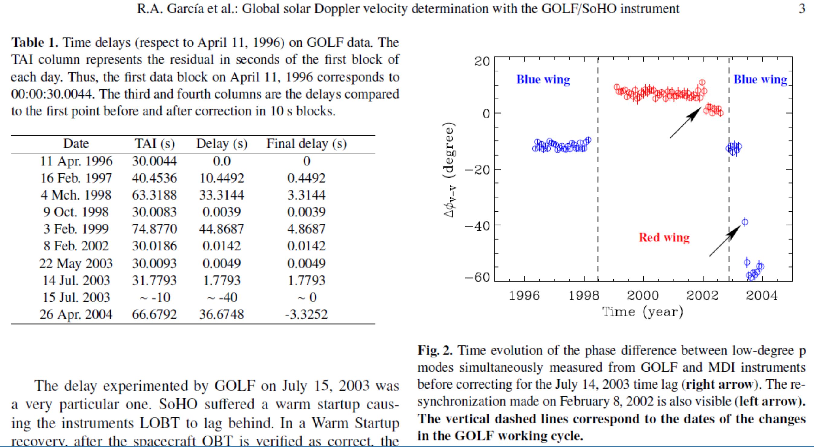
Time (clock) events: 17 on 22 years!

Slide 11
Use of BISON data: phase difference in the p modes [fmin=2850, fmax=3550] mHz
2017: independent work IAS/OCA
Series used by Fossat et al 2017 / BISON; 1 point per day starting on April 11th 1996
BW / RW: 11 s.
BW / ratio: 7 s.
20
Time lag (s)
0
-20
0
days
6000
« BISON, we (you) have a problem ! ». Confirmation thanks to IRIS

Slide 12
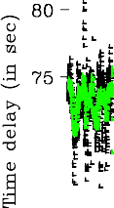
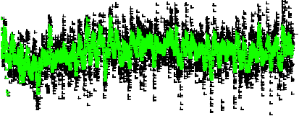
2018: which series is the best ?
Find a series of reference: BISON, IRIS, GONG, VIRGO…
SPM_blue / GONG: OK ! (time delay estimated through a time cross correlation; estimated with a p-mode time correlation over at least 10 days worth of data)
⇒ use GONG (velocity)
Note: ± 1.5 s halo orbit
modulation
Fig. 5. Time diﬀerence between the SPM Blue / VIRGO data and the l = 0 GONG data as a function of time computed using a 10-day window (black dots) and using a 45-day window (green dots).

Slide 13
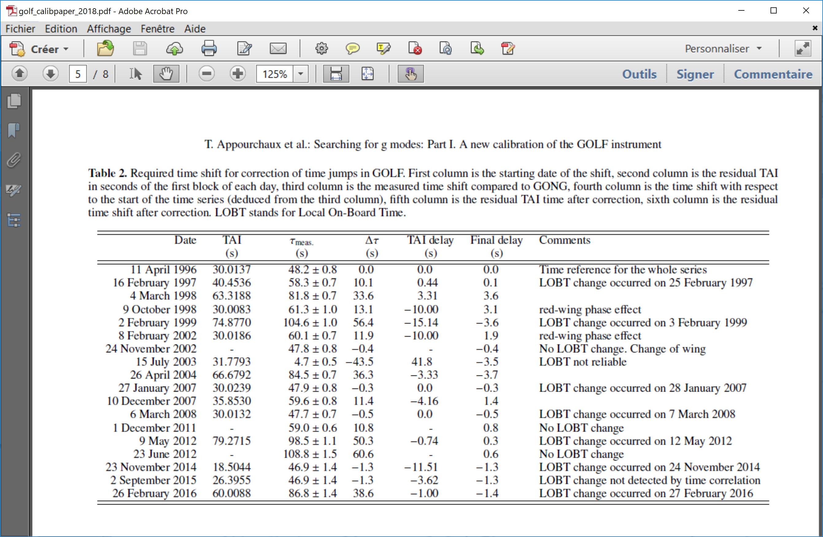
Add or remove samples in the 10-second series, to be in phase with GONG, as perfectly as possible

Slide 14

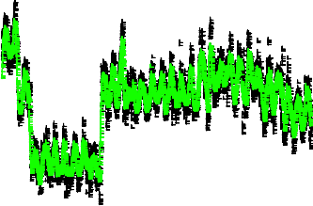

Time diﬀerence between the newly GOLF series and the l = 0 GONG data as a function of time; using a 10-day integration window (black dots) and using a 45-day integration window (green dots).
Operation jumps and the ± 1.5 s halo orbit modulation

Slide 15
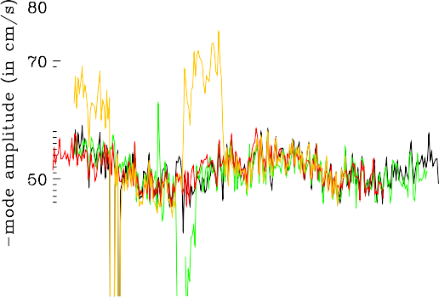
Consistency between series
GOLF_EF17, GOLF_TA18, BiSON, GONG
rms mode amplitude as a function of time for the newly calibrated GOLF data (black), for the GOLF data as used in Fossat et al. (2017) (orange), for the BiSON data (in red) and for the GONG data (in green).

Slide 16
What is « true sampling time » ?
Garcia et al 2005: TAI only, with a 10-second precision. What about RW versus BW ?
Appourchaux et al 2018: continuity with GONG phase, with a 10-second precision.
⇒ The opposite of the red signal is late in respect to the blue, with a mean delay: δ =12 s (Renaud et al), 17° (Pallé et al)

Slide 17
GOLF_EF17 / GOLF_TA18
RW mode
BW mode
BW mode
Time diﬀerence between the GOLF time series used by Fossat et al. (2017) and the the newly calibrated GOLF data as a function of time, both sampled at 80 s.

Slide 18
To understand theses jumps
  Date TAI delta_TAI res_TAI GONG res_GONG
11-Apr-1996 30.01 0 0 0 0
16-Feb-1997 (easy) 40.45 10.44 0.44 10.1 0.1
4-Feb-1999 (special care) 74.87 44.86 4.86 56.4 -3.6
4-Feb-1999 74.87 44.86 + 11(RW) -4.14
9-Feb-2002 30.01 0 0 11.9 1.9
9-Feb-2002 30.01 11 (RW) 1
4 samples
6 s.
0 sample
1 s.
1 sample
Concatenation ⇒ choose the same time basis reference along the whole series !

Slide 19
To be done now
Understand all the events: datation AND correction or flagging (no instrumental correction in the series made by Appourchaux et al 2018).
Concatenation; instrumental corrections; velocity calibration.
Provide the community with long time series, including the hypothesis behind: series with the true sampling time and another interpolated on a regular timeline. NOT an issue for MOST of the studies like low-frequency analysis, but CAN BE, for example, as far as p-mode phase analysis is concerned.

Slide 20
Archive status and plans for the SOHO legacy archive
A 22-year residual velocity series is available through the official archive (new calibration by Appourchaux et al 2018).
> 225 papers published using GOLF data or linked to its analysis.
2 web sites: IAS and Saclay. Work in progress to provide all the information (from operational up to calibration hypothesis) required to fully exploit the data.
Time series, Frequency tables (free of the solar magnetic cycle effect) are provided.
Higher-level data, such as magnetic proxies are available (FP7-SPACEINN Seismic+ gate: http://www.spaceinn.eu/), Salabert et al. (2016).

Slide 21
Present and future
Long-term legacy (CNES policy being experienced).
Frequencies with new time series; P-mode properties along the solar cycle.
Low frequency analysis (g-mode investigation for individual identifications). Modelling. Main challenges: rotation of the solar core: magnitude and inclination axis. Inferences on dark matter.
New solar physics inversion (new opacities; new microscopic diffusion; update from the neutrinos). 3-D modelling with both radiative and convective zones.
Magnetic proxies – Sun as a magnetic star: peculiar or standard ? – Sun used as a reference for asteroseismic (and giant planet seismology) reference.

Slide 22
Highlights
Seismic solar model in excellent agreement with neutrinos (Turck-Chièze et al 2011):
seismic model : 5.3 ± 0.6 10⁶ cm⁻² s⁻¹
SNO : 5.05 ± 0.30 10⁶ cm⁻² s⁻¹
G-mode dipolar detection (García et al 2007, 2011; TBC by identification of individual modes). In favor of a fast solar core rotation. Fossat 2016 (submitted), estimated g-mode rotationnal splitting not consistent with García et al. Work in // @IAS.
Constraints on the mass of WIMPS, candidates for dark matter (Turck-Chèze & Lopes 2012):
M_WIMPS > 10 GeV

Slide 23
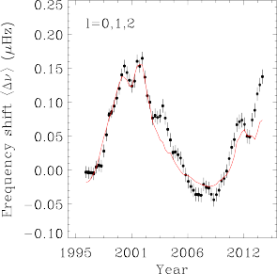
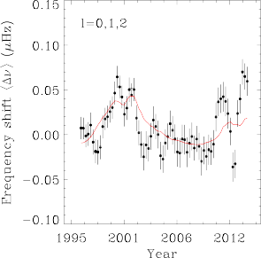
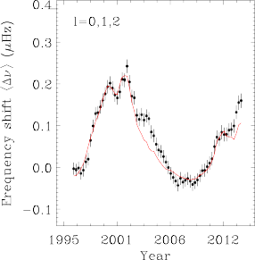
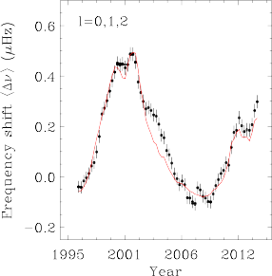
Highlights – Solar activity 1
confirmation of the start of cycle 24, although not visible in surface proxies (Salabert et al 2015).
biennal oscillation discovery.
1800 µHz ≤ ν < 3790 µHz
1800 µHz ≤ ν < 2450 µHz
2450 µHz ≤ ν < 3110 µHz
3110 µHz ≤ ν < 3790 µHz
Temporal variations of the frequency shifts in µHz averaged over the modes l = 0, 1, and 2, (∆ν_{n,l=0,1,2}), and calculated for four different frequency ranges (black dots). Red solid line: scaled 10.7-cm radio flux.

Slide 24
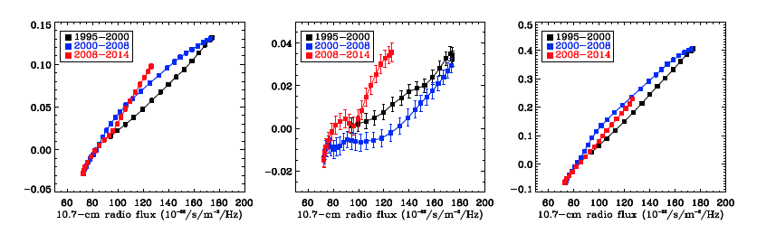
Highlights – Solar activity 2
Location of the magnetic cycle (Salabert et al 2015):
Low-frequency modes (sensitive to the deeper sub-surface layers below 1400 km) show nearly unchanged frequency shifts between Cycles 23 and 24.
The modes at higher frequencies (sensitive to upper shallower regions) show frequency shifts 30% smaller during Cycle 24, which is in agreement with the decrease observed in the surface activity between Cycles 23 and 24.
1800 µHz ≤ ν < 3790 µHz
1800 µHz ≤ ν < 2450 µHz
3110 µHz ≤ ν < 3790 µHz

