Slide 1
About the asymptotic g-mode detection 1. Asymptotic g modes: Evidence for a rapid rotation of the solar core E. Fossat¹, P. Boumier², T. Corbard¹, J. Provost¹, D. Salabert³, F. X. Schmider¹, A. H. Gabriel², G. Grec¹, C. Renaud¹, J. M. Robillot⁴, T. Roca-Cortés^{5,6}, S. Turck-Chièze⁷, R. K. Ulrich⁸ and M. Lazrek⁹, Astronomy & Astrophysics, Volume 604, August 2017 2. More about solar g modes E. Fossat and F. X. Schmider, Astronomy & Astrophysics, Volume 612, April 2018
Eric Fossat
SOHO-29, Nice
27 November, 2018

Slide 2
Internal rotation

Slide 3
Method: (similar to ) ultrasonic scan
Idea: identify a differential p-mode parameter and use it for the detection of a collective signature of g-modes, all together, in the very low frequency asymptotic regime!

Slide 5
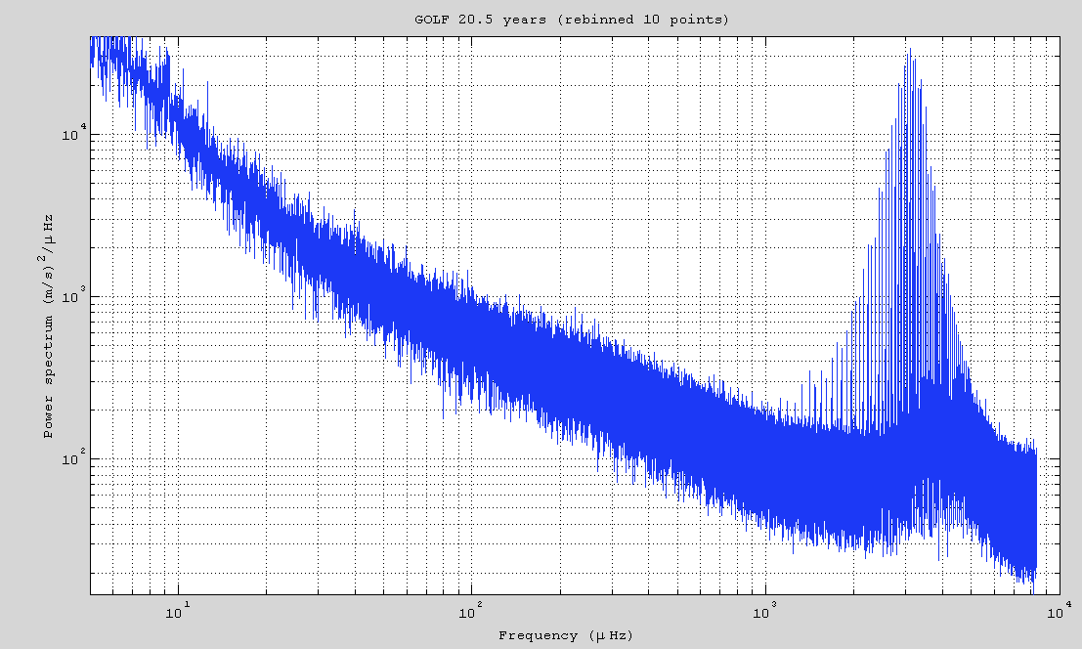

Slide 6
G-mode asymptotic (approximate) properties
Degree by degree, splitting independent of radial order
But splitting different for different degrees, modified by a Coriolis coefficient, (1-1/l(l+1)), i.e. 0.5 for l=1, and 5/6 pour l=2
For degree, periods are équidistant,
The best models predict a value of Po of about 34 - 35 min.
It implies period equidistances P1 ≈ 24 min and P2 ≈ 14 min.

Slide 7
Data set used: 16.5-year of full disk measurements by GOLF 1996 – 2012, 96% filling

Slide 8
Mean of 36161 p-mode spectra computed on 8 hours between 2.3 et 3.7 mHz

Slide 9
The same approximately flattened

Slide 10
An example of 8 h

Slide 11
Its spectrum

Slide 12
End of first step: These are the 36131 values of T(t) fluctuations, sampled at 4-hour intervals, and limited at ± 240s. There are 34261 non zero values, and their rms deviation is 52 s.

Slide 13
2nd step : power spectrum of T(t) Most interesting is the almost absence of a low frequency tendency in 1/f that opens the hope for success.

Slide 14
Model of 75 modes of degree 1

Slide 15
Possible model of g modes of degrees 1 and 2

Slide 16
Its autocorrelation in the range 6 – 30 µHz

Slide 17
Same model, deeply embedded in a lot of noise

Slide 18
Autocorrelation of (model + noise)

Slide 19
Search for a splitting signature in the autocorrelation of the large separation spectrum

Slide 20
The g-mode splitting equations present a very peculiar specificity in the case of our measurement: s(1,m)=m(Ω/2 - ω) nHz [1] s(2,m)=m( 5Ω/6 - ω) nHz. [2] Usually, ω = 31nHz (one year period) Here we must understand that ω = 433 nHz (sidereal rotation of our « instrument », which is the set of full disk p modes)

Slide 21
Consequence of Equation (1) : s(1,1) = (Ω/2 - 433) nHz s(1,1) is negative if Ω < 866 nHz But the autocorrelation does not see a difference between a positive and a negative splitting There could be two different rotations rates Ω providing the same splitting s(1,1) With our peak at 209 nHz, the choice is Ω ≈ 446 nHz or Ω ≈ 1282 nHz

Slide 22
Test of A(s(1,1) + A(2,1) + A(s(2,2) as a function of Ω

Slide 25
next step: search for the asymptotic equidistance period spacing example: the “easy” case of l=1
We look for an equidistance of 24 to 25 minutes
We know the splitting: 210 nHz
We can then test a model of many g modes triplets in our frequency range 5.5 – 34 μHz with 2 free parameters: equidistance and position
Caution: high density of modes in the very low frequencies. The best results are obtained by starting near 7 μHz

Slide 28
Mean of 76 spectrum layers separated by 1443 s in periods

Slide 29
Mean of 76 spectrum layers separated by 1443 s in periods, and symmetrized (for checking the symmetry of the split components)

Slide 30
Cross-correlation model-spectrum for l=1, s/n=8.5

Slide 31
Complete model including l=1, 2, 3 and 4

Slide 32
Its cross-correlation with the large separation spectrum
S/N > 12 !!!

Slide 33
With the mean of 3 spectra and the model including only l=1 central frequencies, without tesseral components. s/n > 6

Slide 34
With the mean of 3 spectra and a model including only l=1 split frequencies

Slide 35
First 10 years, s/n = 8
Last 6 years, s/n = 8

Slide 36
Higher half of the frequency range s/n>10
Lower half of the frequency range s/n>10

Slide 38
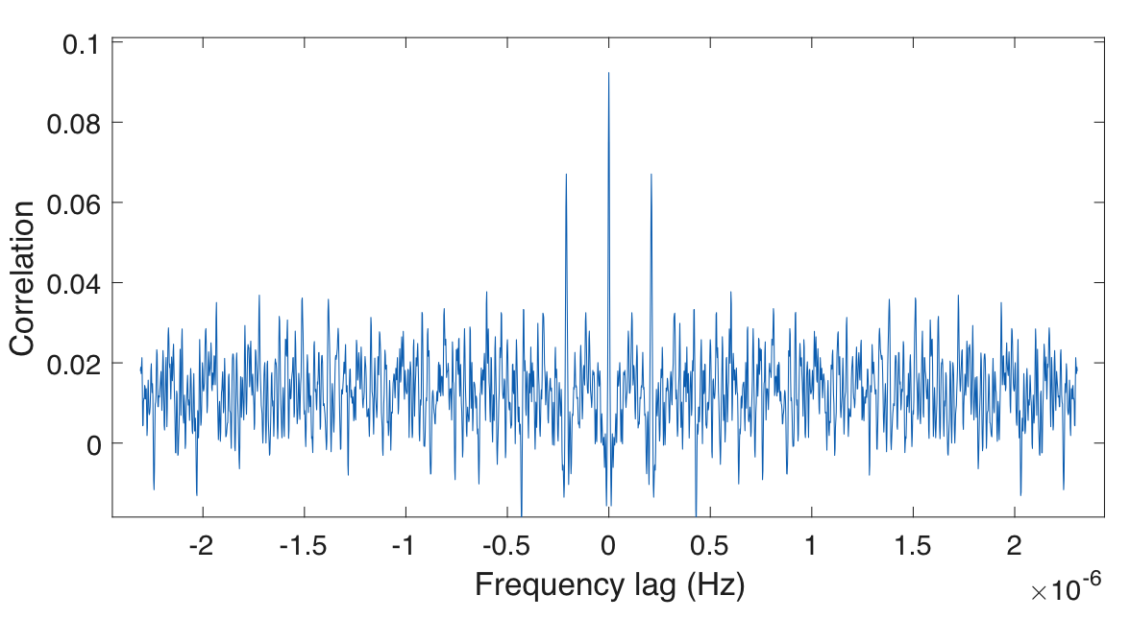
l = 1 alone, “original”
s/n = 8.5
L = 1 alone, with sampling 5h/10h
s/n = 7.75

Slide 39
Complete model, mean of 4 cross-correlations (4h/8h & 5h/10h), s/n > 11

Slide 40
l = 2&3&4, mean of 4 cross-correlations (4h/8h & 5h/10h)
s/n > 7

Slide 43
Main results
We have now in hands:
4 asymptotic equidistances, all consistent between them within about 1 second, and consistent with the asymptotic equation !
2 equations describing the small departures from equidistance for l=1 and l=2
4 measurements of the mean g-mode kernels rotation, all consistent within 1 nHz, and with the asymptotic equation
A rapid mean core rotation, averaging at one-week period (vertical gradient of 4000 km/h between core and envelope). How sharp is this “second tachocline” ?
Difficulty of understanding the process that makes these modes so clearly detected, as well as their distributions of amplitudes, with degree and tesseral order.

Slide 44
Thanks for your attention
Eric Fossat
SOHO-29, Nice
November 27, 2018.

Slide 47
l = 1, complete

Slide 48
l = 1, only tesseral components

Slide 49
l = 1, only central components

