Slide 1
Total Solar Irradiance: What have we learned from the 23-year Record of VIRGO TSI?
Claus Fröhlich
CH 7265 Davos Wolfgang

Slide 2
Outline
Operation of DIARAD and PMO6V radiometers within VIRGO, how do we get the data and how are the corresponding level-1 produced
From level-1 to level-2: Development of a model for long-term changes of radiometers in space and its application to the VIRGO record.
Application of the long-term-change model to ACRIM-I and HF and combing the data from HF, ACRIM I-III and VIRGO to the socalled PMOD composite

Slide 3
Operation of the VIRGO Radiometers
The two PMO6-V, A and B and the DIARAD with cannels Left and Right are operated with shutters in the so-called active mode, meaning that they are alternatively open-closed with a 60 and 90 second cadance, respectively
After the failure of the both PMO6V shutter operation at SOHO-Md 72 a new operation at Md 83 was started. The cover of PO6V-A is normally open and the one of B normally closed. In order to get a reference for A the cover is closed every 8 hours for a few 3-minute periods. Up to Md 216 the cover of B was opened during 33 minutes around the closing of A, afterwards the opening of B was reduced to every 7, later to10 days to reduce its exposure.
This cover operation is performed with time-tagged commands, sent to the SOHO FOT every Fryday for uploading during the next week.
The timing is based on the daily pulse from SOHO. After a switch-off we have to re-sychronize VIRGO to this pulse. The first sychronisation was correct on the agreed TAI-30 seconds. After the LOI cover opening the synchronization was made on Tai+0 seconds which is maintained for all following switch-offs. So relative to GOLF and MDI the VIRGO data are shifted by 30 seconds.
The VIRGO radiometers read during 10 seconds starting at 40 and 50 seconds, so the mean of the two measurements is centered at 50 seconds or 20 seconds after the minute respectively. For DIARAD a irradiance is calulated at every 3 minutes and it takes the last value which is at 55 seconds or 25 seconds

Slide 4
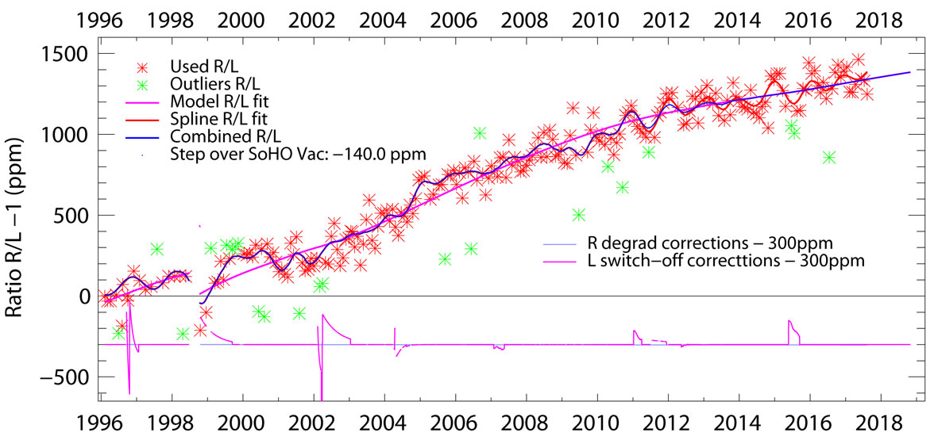
Level 1 of DIARAD
Level 1 of DIARAD is calculated at the VDC with the procedures as designed by IRMB before the start of the mission. These data are available as level 1 irradiance every 3 minutes, besides the periods when electrical calibrations are performed
Once per month DIARAD-L is replaced by DIARAD-R to determine degradation by comparing the results of the two with a exposure ratio of 1 to 1440.
In September 2017 the shutter of DIARAD-R failed and the degradation model has to be used to determine this ratio afterwards.

Slide 5
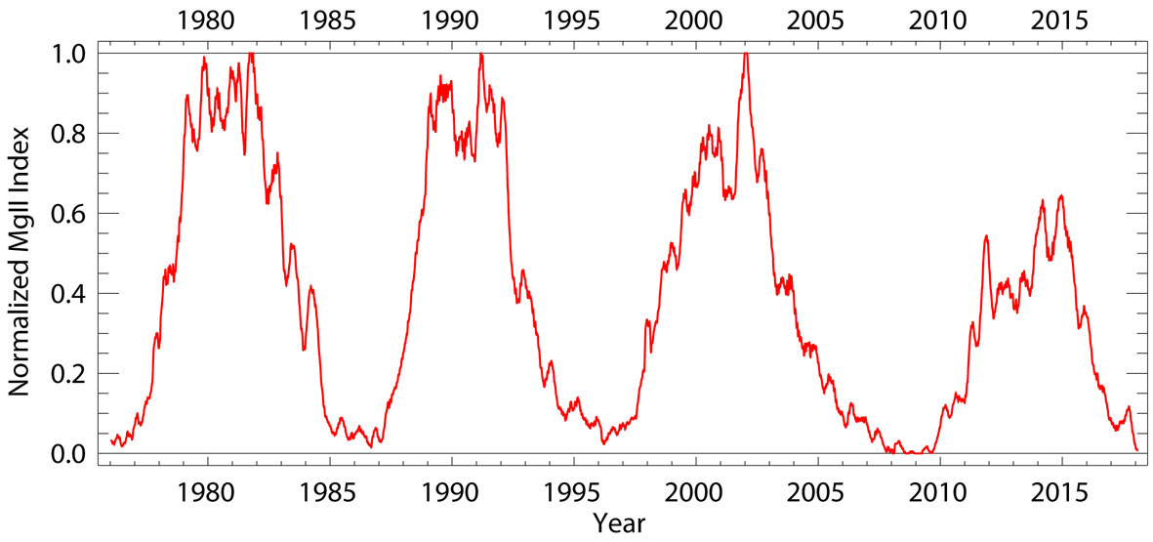
Description of the degradion model

Slide 6
Level 1 of PMO6V
The original procedure to determine Level 1 data was developed by Wolfgang Finsterle during his PhD in 1996 and was in use up to the failure of the DIARAD R shutter. It is clear that all the knowledge we have now could provide a better algorithm.
One issue are the missing temperatures which are not part of the science data but added from the houseeeping data afterwards at the VDC. The cience data are transmitted 3 times with the actual, 12 and 25 hours delayed data and hence we can retrieve lost data in the transmission. But the tempertures from the housekeeping may be missing and have to be interpolated.
The analysis of the variations during closing and opening of in the cover mode needs to be improved
PMO6V-A has only a few closed values every 8 hours and we need a ‘closed’ value each minute to determine TSI.

Slide 7
Temperature interpolation

Slide 8
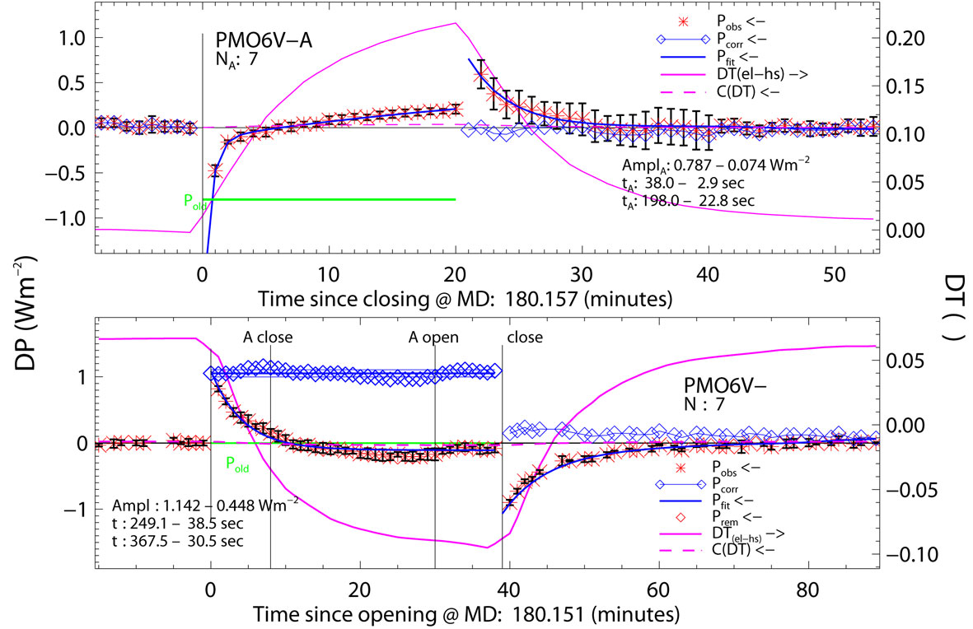
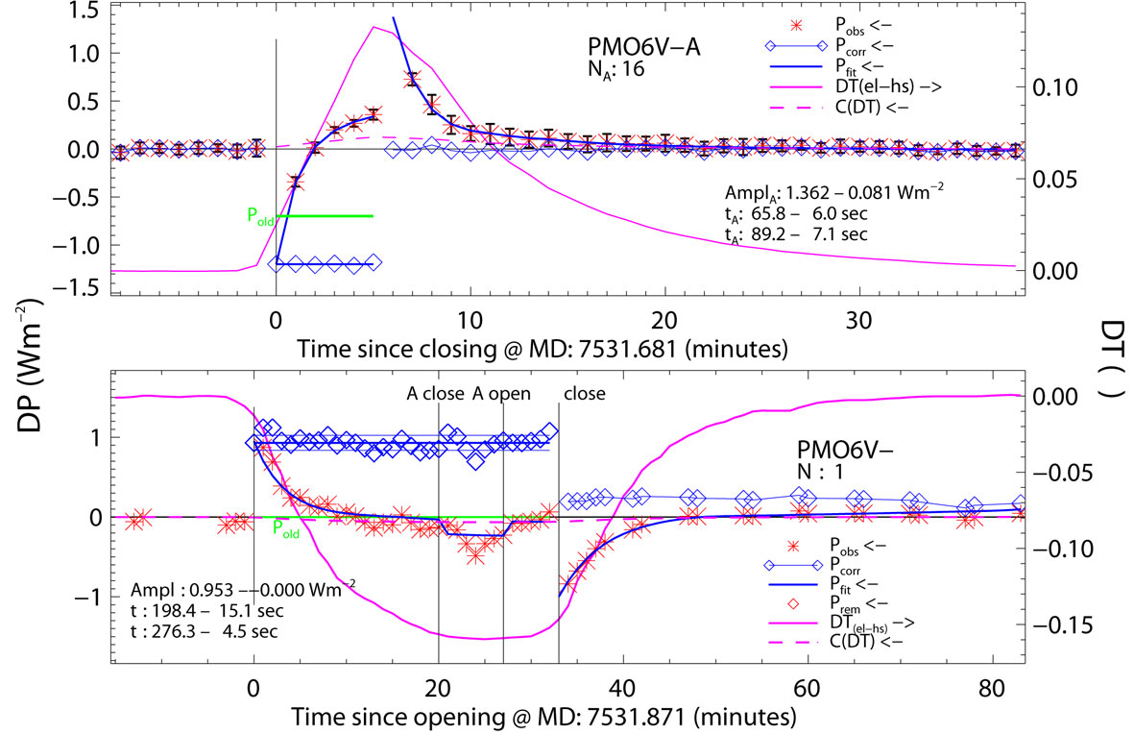
Opening and closing

Slide 9
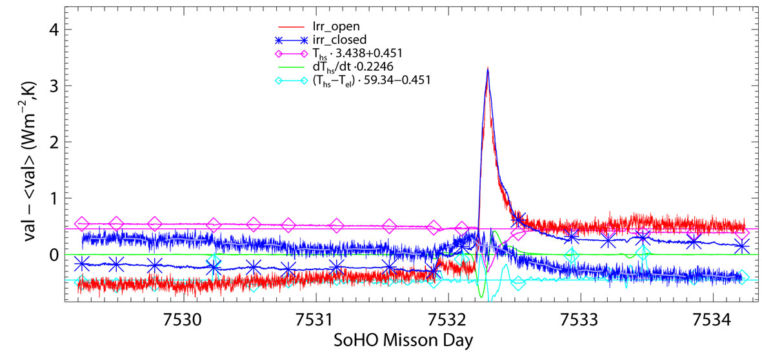
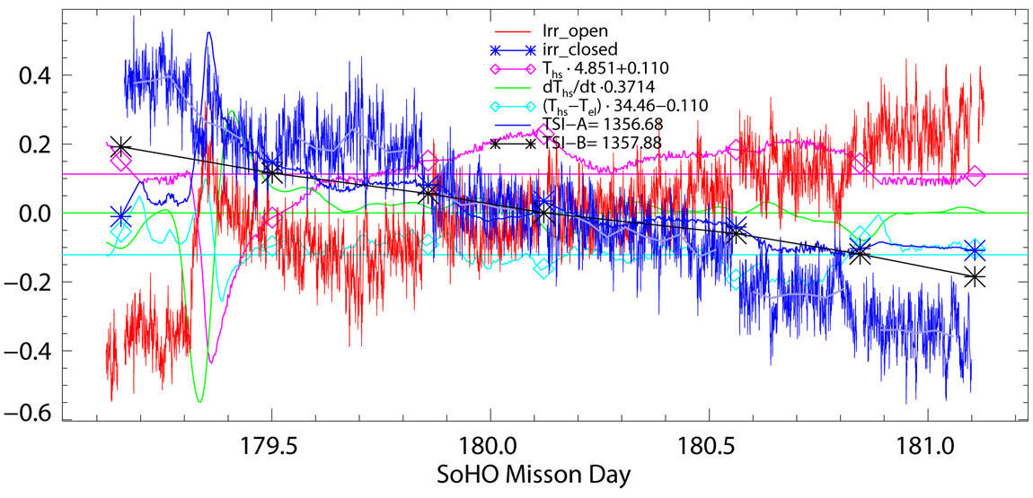
Reconstruction of the ‘closed’ values for PMO66V-A

Slide 10
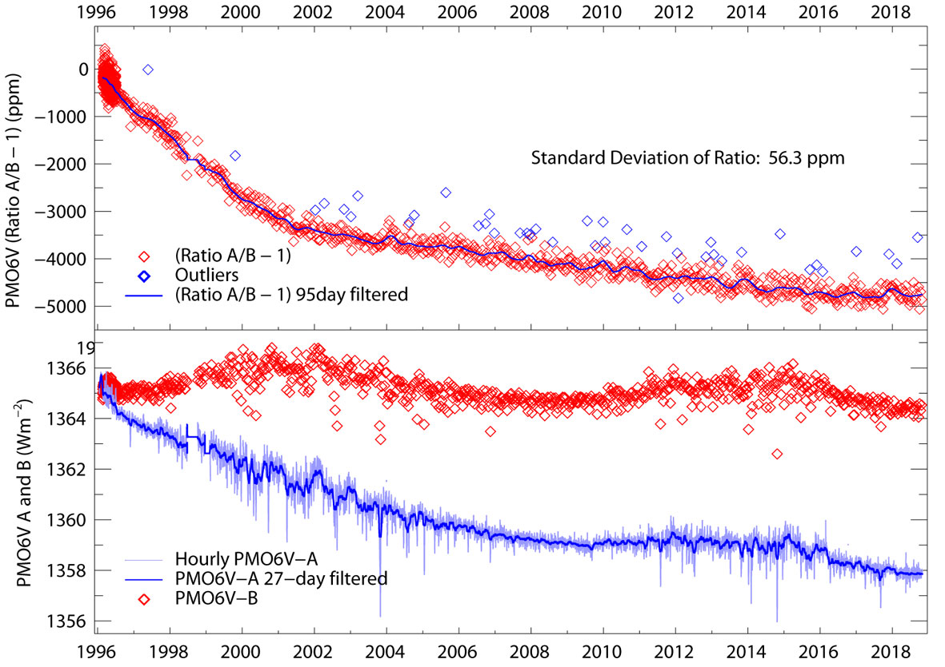
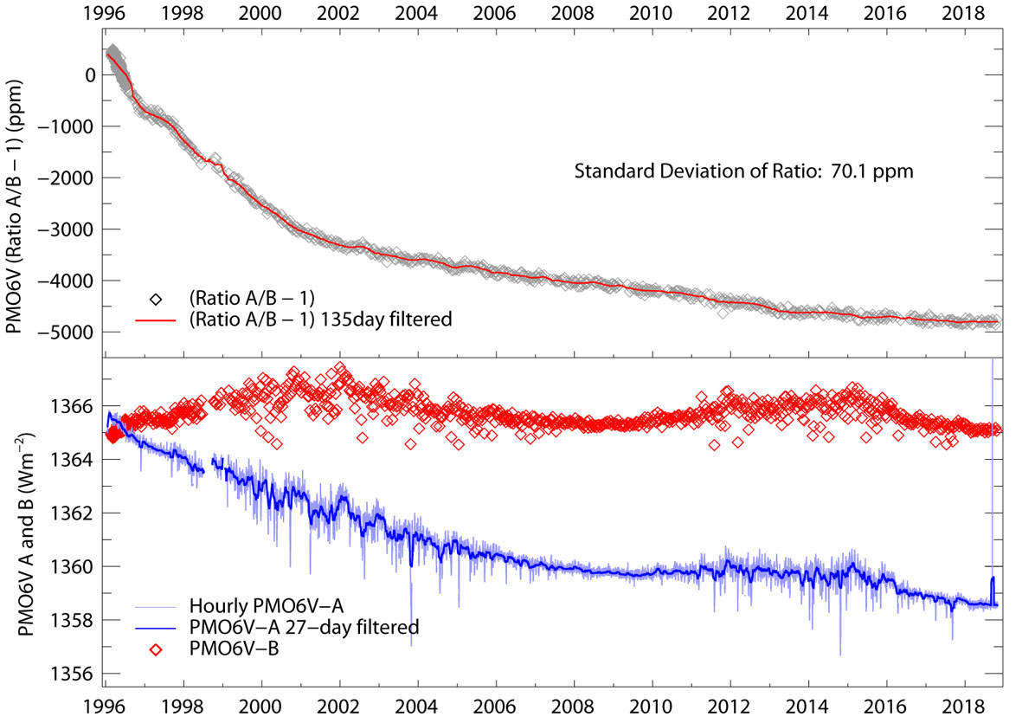
Level-1 data and ratio A/B

Slide 11
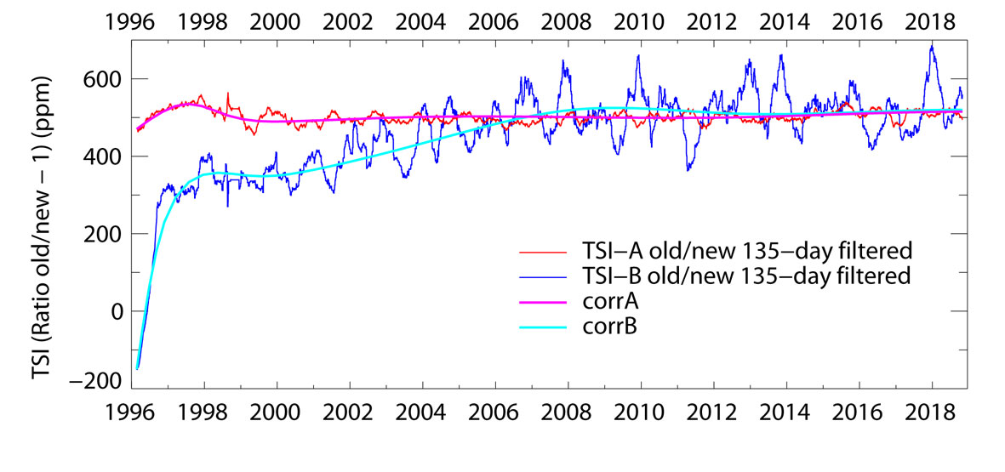
Comparison of the new with the old

Slide 12
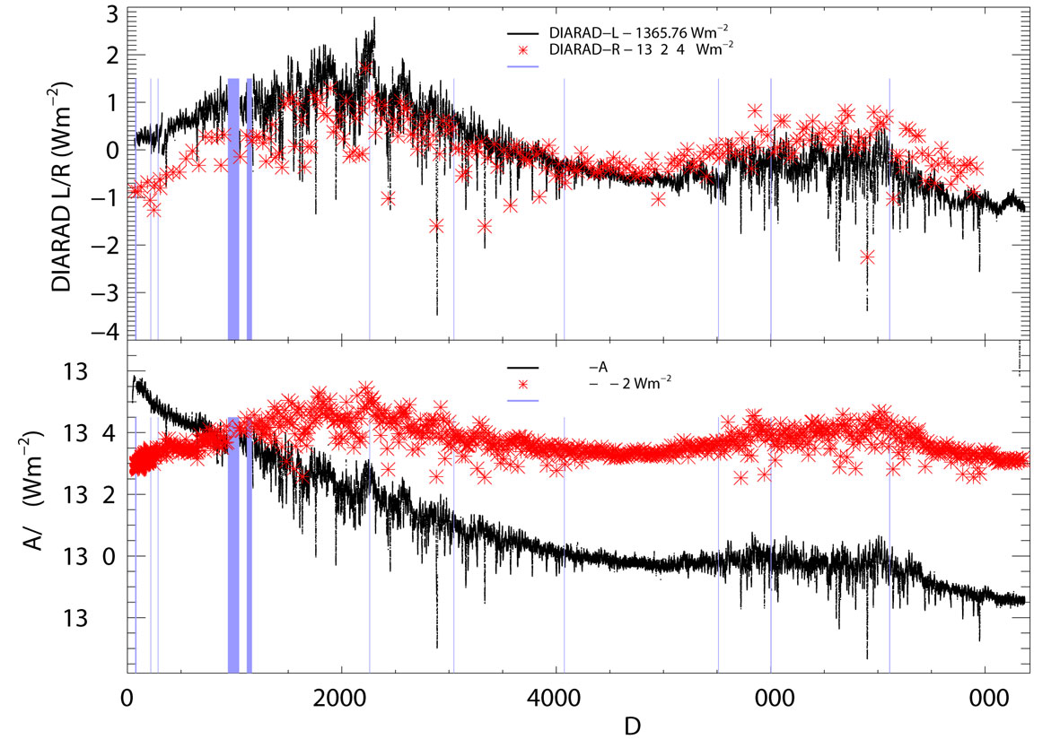
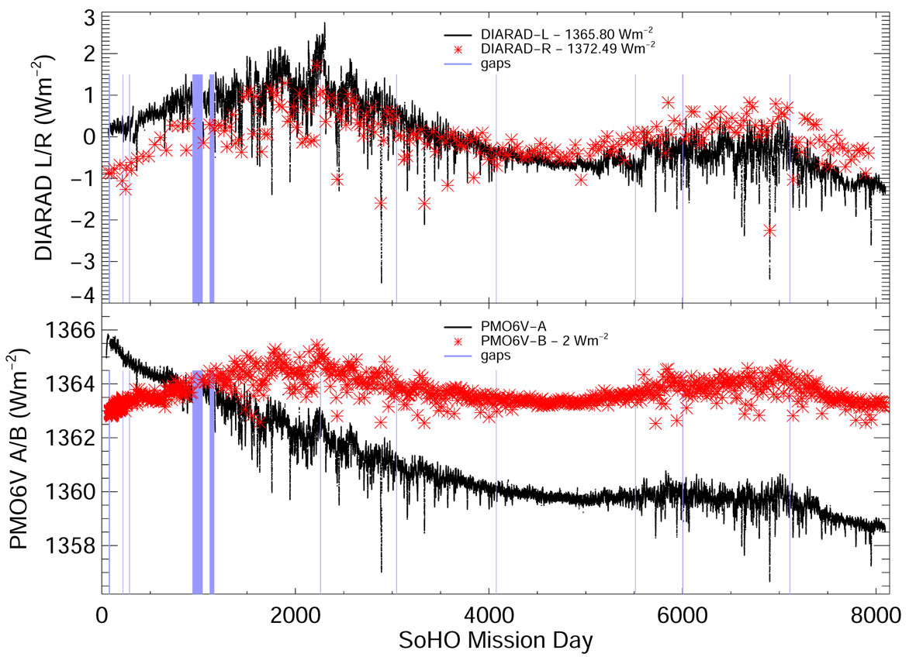
The new level 1 data

Slide 13
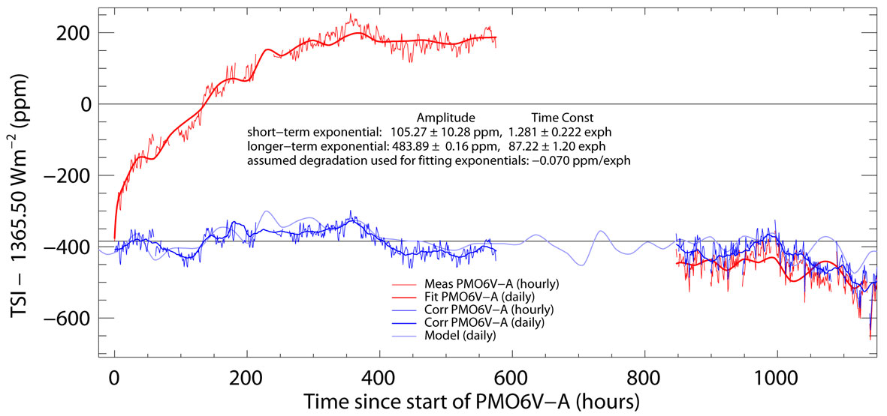
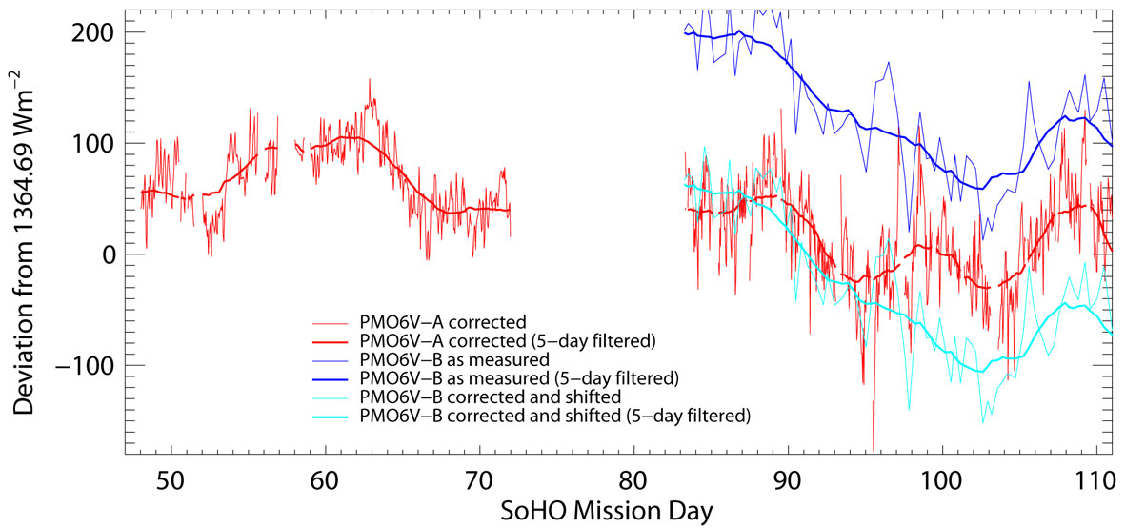
How to treat the early increase?
A and B values at first light: 1364.6911 and 1361.7925
Ratio A/B at first light: 1.0021285

Slide 14
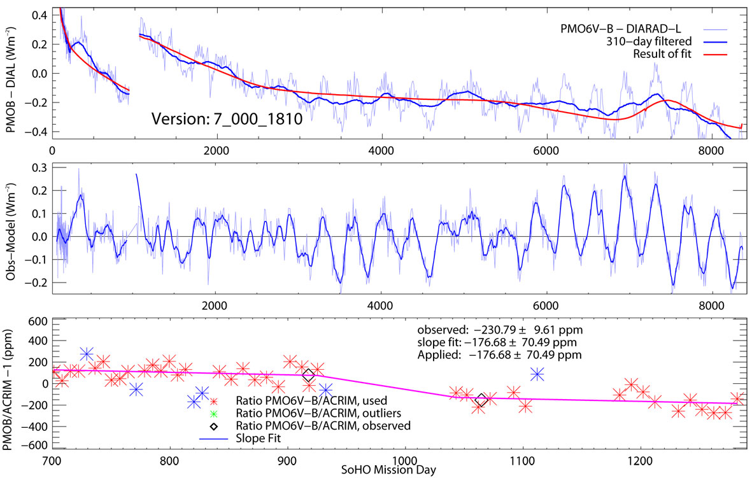
Correct PMO6V-B for its different exposure with time
PMO6V-B was exposed at the beginning every 8 hours for 33 minutes and accumulated upto Md 218 10.6 day of exposure. From then on 24.2 days of exposure have been added until present. So the degradation of PMO6V-A cannot be determined from direct comparison of A and B. Instead it is determined from comparision with DIARAD which shows a non-exposure sensitivity increase.

Slide 15
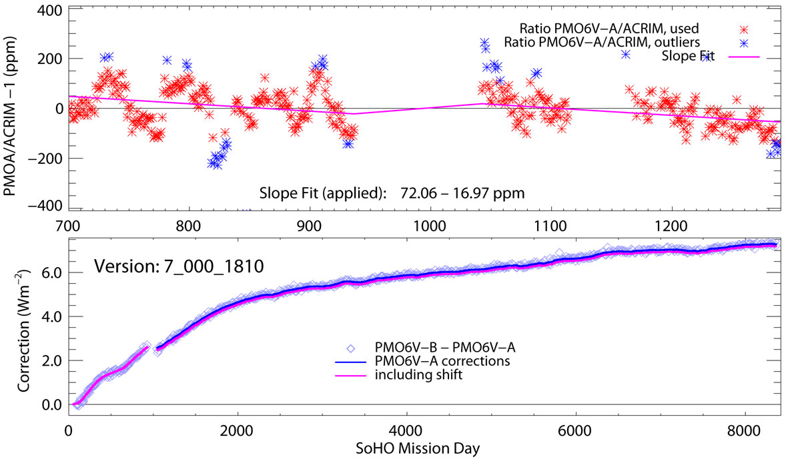
Using corrected PMO6V-B to correct PMO6V-A

Slide 16
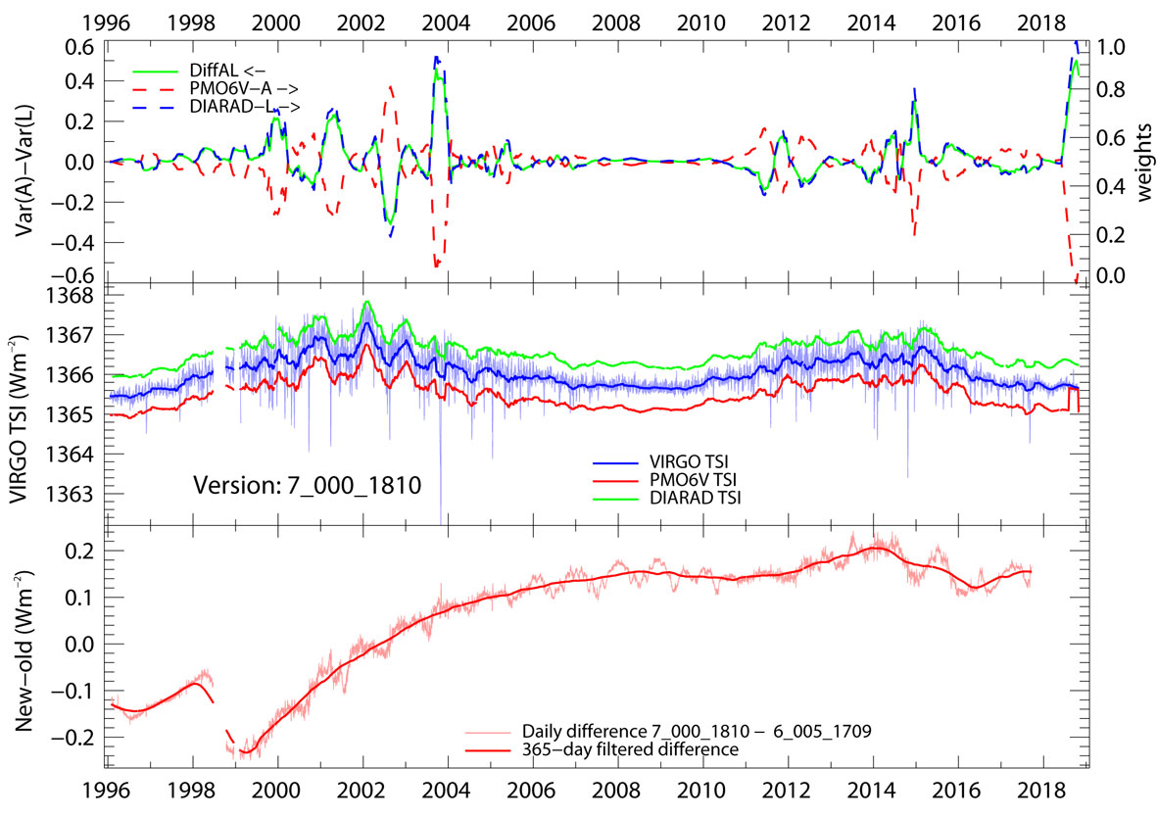
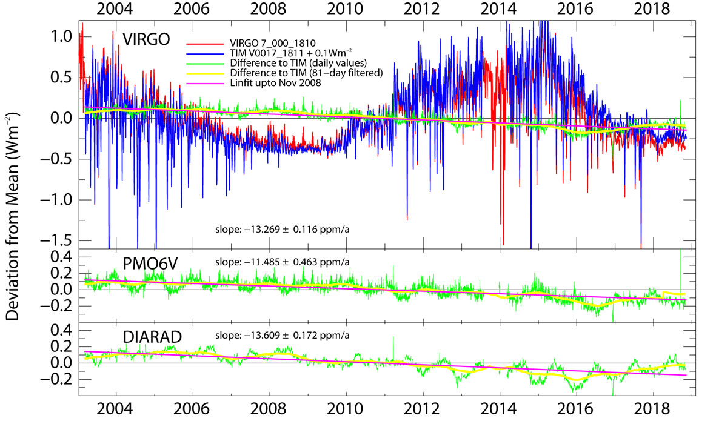
Final VIRGO TSI

Slide 17
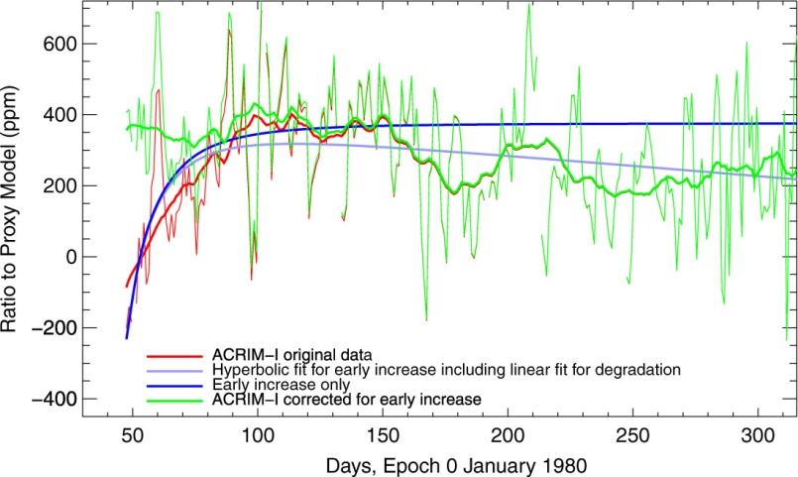
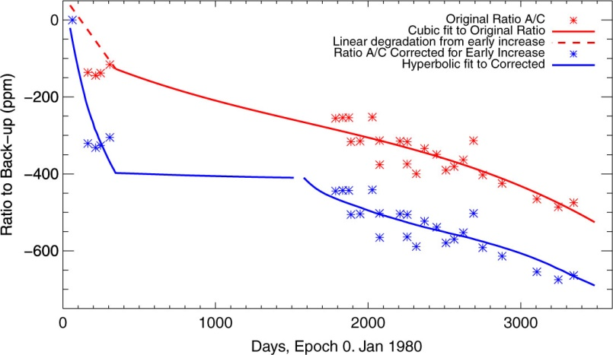
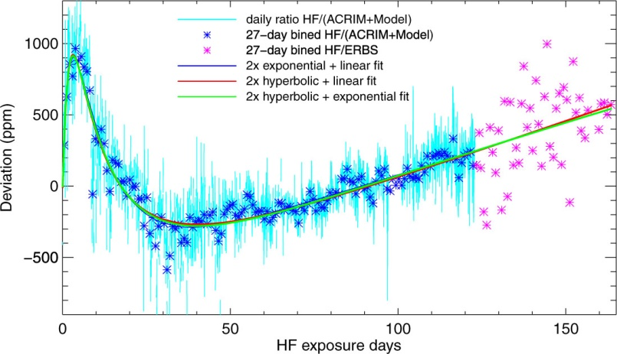
Using the degradation model for HF and ACRIM-I

Slide 18
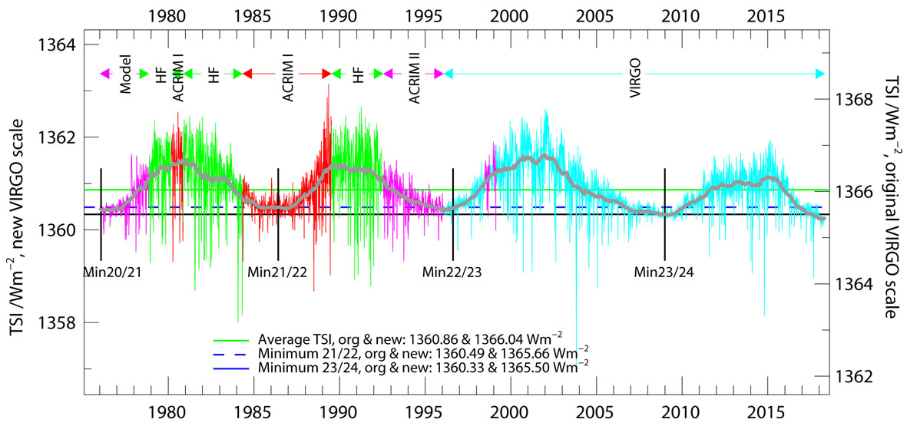
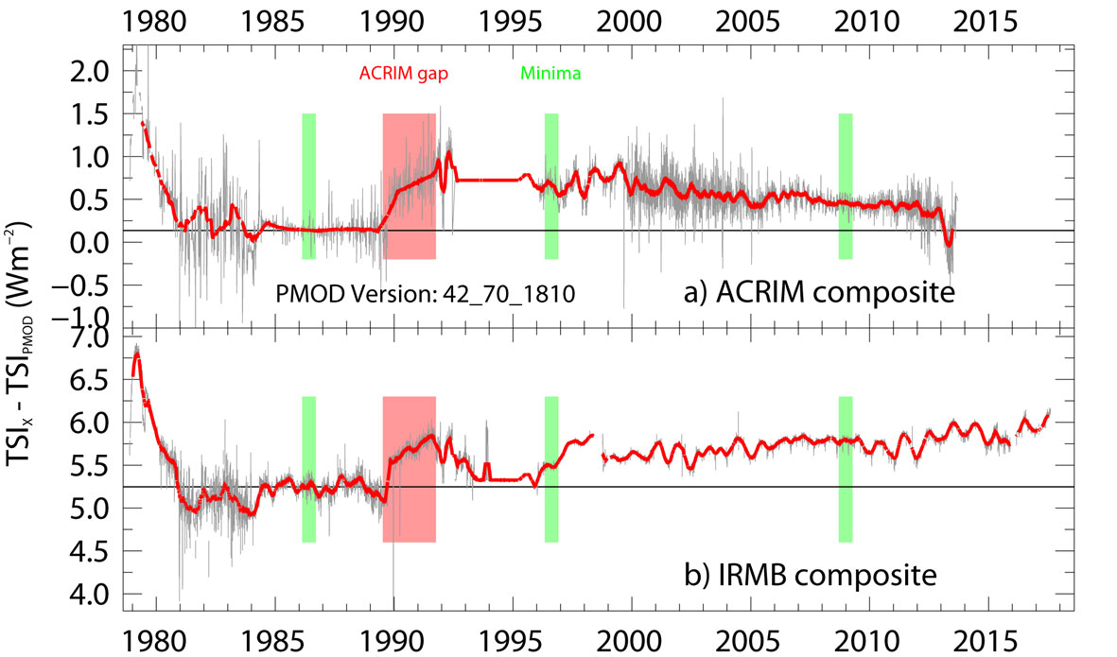
With all this we get the PMOD Composite

Slide 19
Conclusions
The 23-year record is a great opportunity to study degradation of radiometers in space
It is astounding that a model with exponentials and UV dose can work over such a long period of time. This allows us also to correct ACRIM and HF timeseries for a reliable composite TSI
The use of two different radiometer types is essential to disentangle and quantify longterm changes in space. It was an important argument in the proposal, now its obvious
The new level 1 evaluation procedure improves the VIRGO TSI, but it still needs some work for the details...........
Thanks to the scientists and engineers of SOHO team

